Slide 1

Super Store Sales Analysis

Slide 2

Agenda
The Dataset
Dashboard
Findings
Suggestions

Slide 3
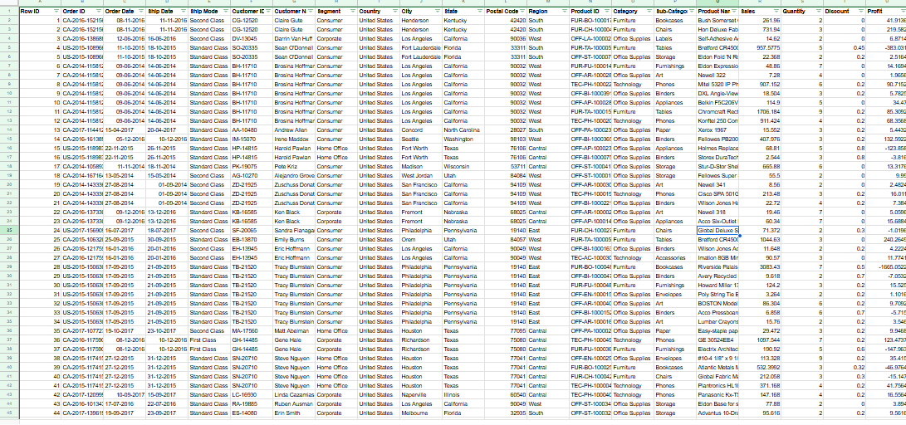
The Dataset

Slide 4
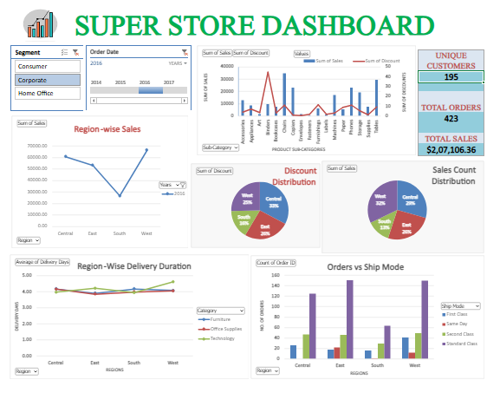
Dashboard
Dashboard link

Slide 5
Findings
1(a). Super Store is giving a lot of discounts on Binders, despite it already being one of their top selling products in all the customer segments across all regions. | Click here
1(b). Super Store is spending too much of their discount budget on their stores in Central region. Stores especially in Southern region are comparatively lacking in discounts. | Click here
2. Only one product was sold in 50.65% of the total orders. | Click here
3. Delivery duration in Central region is comparatively slow. Average delivery in Central region takes 0.21 days more for Home Office consumers than overall delivery duration average for the same. | Click here

Slide 6
Suggestions
1. Discounts should be reduced from Binders (Sub-category) or Office supplies (Category) in general, as they have decent enough sales. Discount budget should be disbursed to the stores in Southern region for sales spree to attract customer attention.
2(a). In case of their online stores, investment shall be made on machine learning techniques so that people buying only one product from a category shall be recommended with other related products from that same category.
2(b). In case of offline stores, Super Store shall invest in Planograms (Product Display). More information about how planograms leading to improved sales can be found in the referred link. | Click here
3. Delivery duration should be reduced in the stores in Central region by introducing ship mode upgrades wherever it's possible. Decreased delivery duration may lead to increase in sales.

Slide 7
Final Words
There is a lot of analysis that come out of this dataset.
Further analysis could be made to find out the return rate of the company, the customer retention rate for each region and how average order value vary by region and other factors in the data.
Lastly, further analysis could be made to figure out the most common shipping mode for products in the furniture category to see if processing times could be affecting the category's sales.

